Slide 1


EDA on Movie Data
Anand Kumar Potu
April 2020

Slide 2
Agenda
Problem definition
About data
Pre-profile
Preprocessing of data (Clean, remove unnecessary, add relevant data)
Post-profile
Assumptions / Questions
Conclusion or Summarization
Actionable Insights

Slide 3






Problem definition
In a world... where movies made an estimated $41.7 billion in 2018, the film industry is more popular than ever. But what movies make the most money at the box office? How much does a director matter?

Slide 4
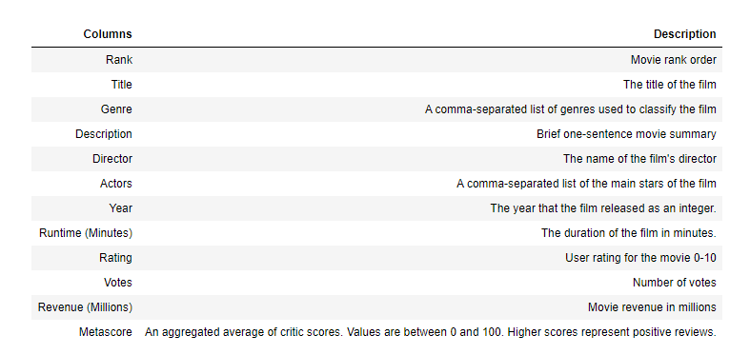
About data

Slide 5
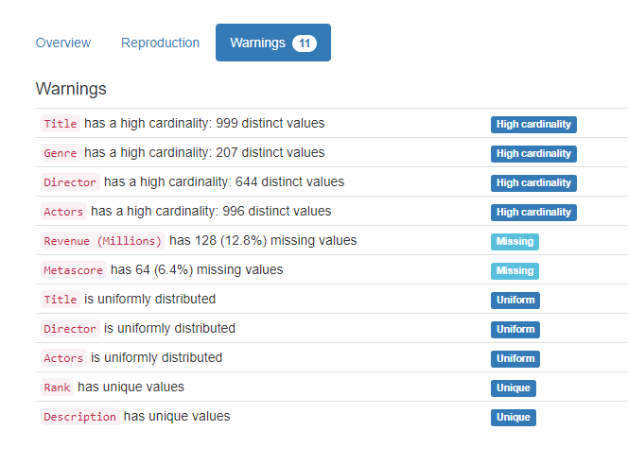
Pre profile
Two important missing value
Columns & Percentage missing
"Revenue (Millions)" - 12.8%
"Metascore" - 6.4%
Column "Title" has 2 "The Host" elements from different years.

Slide 6
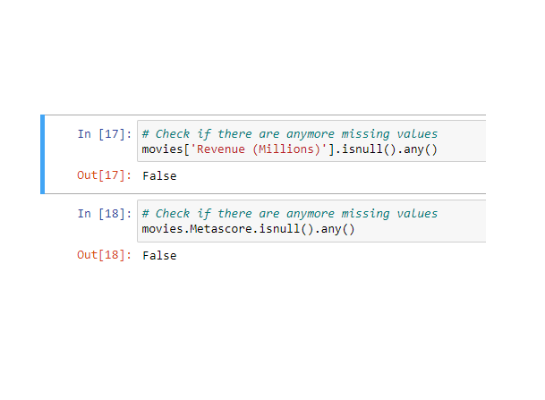
Preprocessing of data (Clean, remove unnecessary, add relevant data)
replaced the missing values with the median of respective column values
Verified the and confirmed that there are no missing values, extreme outliners etc.
Finally dataset is ready for post profiling after processing the data.

Slide 7

Post profile
Correlation is positive for "Votes" and "Runtime" with respect to "Revenue"
"Runtime" is one factor that production firm can control before release.
Now let's see how other elements that influence revenue of a movie.

Slide 8

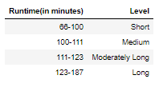

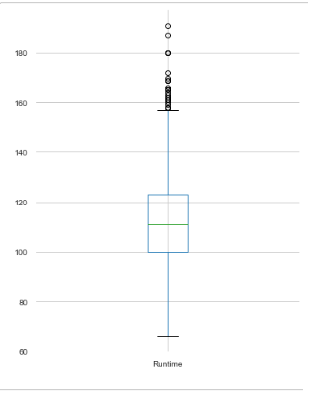
Assumptions/ Questions
How runtime effect revenue?
From histogram we can see runtime between 100 – 123 has high frequency.
Based on plot graph divided runtime into 4 levels
"Short"
"Medium"
"Moderately Long"
"Long"
3. From the bar chat we can see movies with Long runtime level scores more revenue

Slide 9
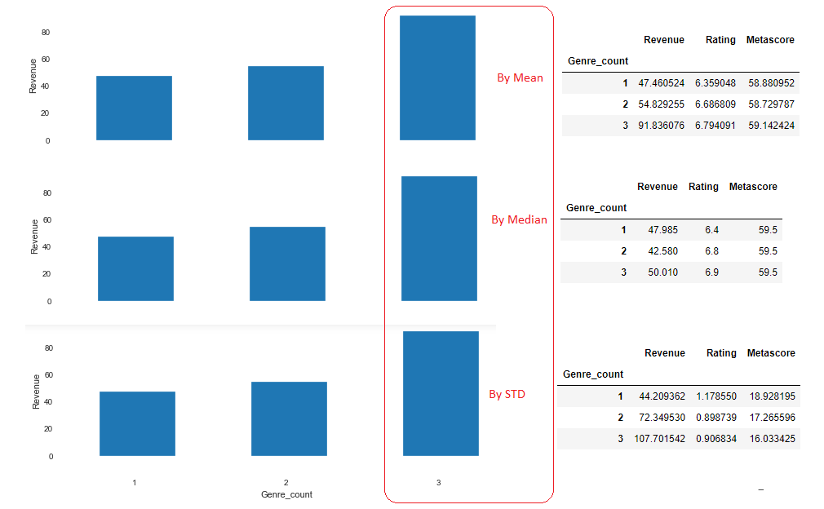
Assumptions/ Questions: How Genre count and type effect Revenue?

Slide 10
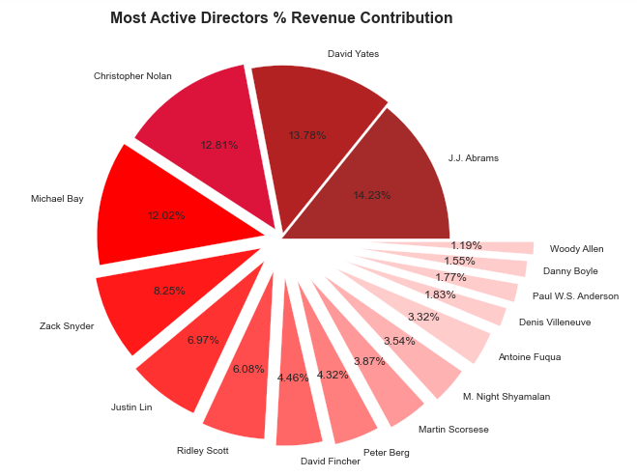
Assumptions/ Questions
How much does a director matter?
Active director J J Abrams's movies earn more in terms of Average Revenue
Highest average revenue is James Cameron with 1 movie
I couldn't find any clear co-relation betweeen revenue and director.
A special analysis with more data fields can justify question does a director matter.

Slide 11
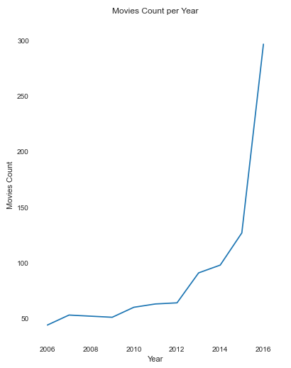
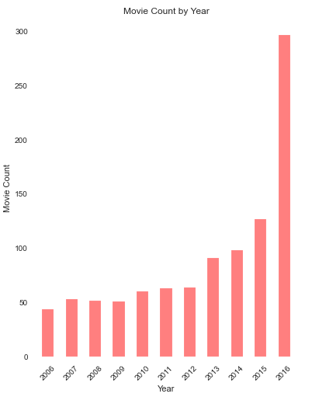
Assumptions/ Questions
Does industry grow over years?
Between years 2013-2016 constant uptrend in the number of movies produced is observed.
2016 has highest number of movies produced which is more than double of 2015.
Yes, over the years movie industry is growing with number of movies.

Slide 12
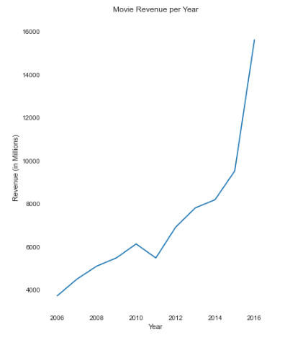
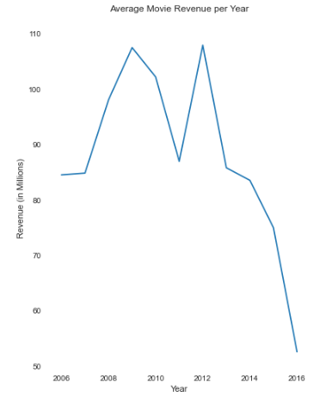
Assumptions/ Questions
How Revenue from movies increasing over the years ?
The revenue of movies increased over year.
But the average revenue of movies is reduced drastically.
Yes, In the form of more movies and total revenue the movie industry is growing.

Slide 13
Conclusion or Summarization
How runtime effect revenue? - Runtime more than 123 minutes earns more revenue
How much does a director matter? - I couldn't find any clear co-relation betweeen revenue and director.
Does industry grow over years? - Yes Industry is growing over year in terms of number of movies and revernue but the average revenue of a movie is decreased over year.
How Genre count and type effect Revenue? - A movie with 3 Genre earns double the movie with 1 Genre.

Slide 14
Actionable Insights
Produce movies with long runtime - Produce movies more than 123 minutes.
Produce more movies - As the industry is growing fast and revenue increasing with respect to number of movies, producing more movies can earn decent revenue.
Produce movies with 3 Genre combination - Movie with 3 Genre can result more Revenue.

Slide 15
Thank you

